Slide 1

COMPUTER SCIENCE OVERVIEW
At a glance

Slide 2
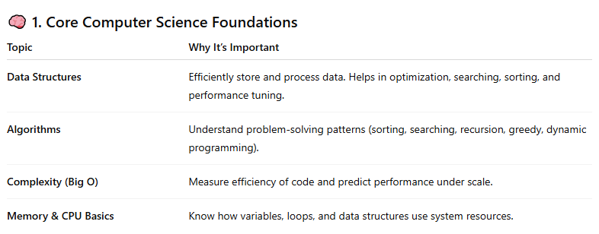

Slide 3
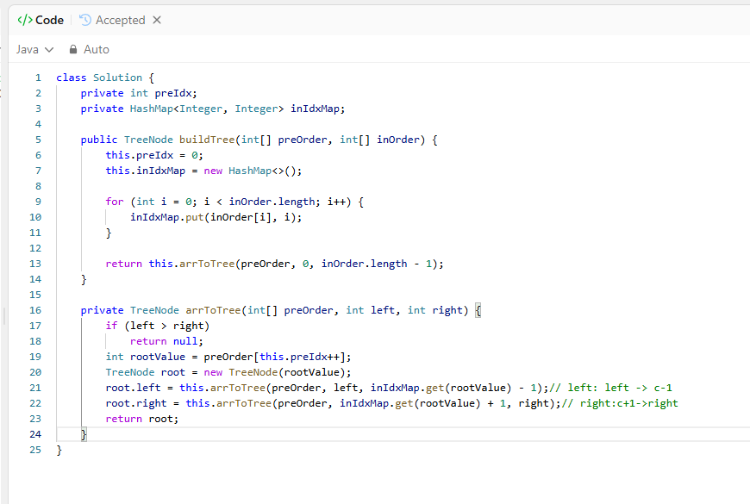
https://leetcode.com/problems/construct-binary-tree-from-preorder-and-inorder-traversal/

Slide 4
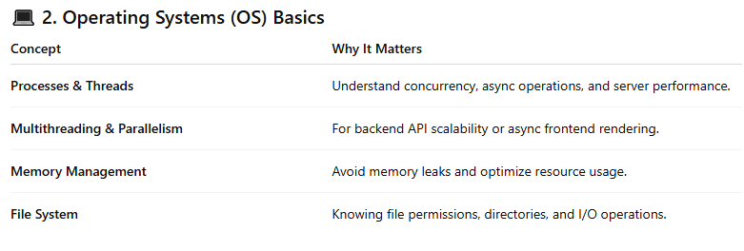

Slide 5
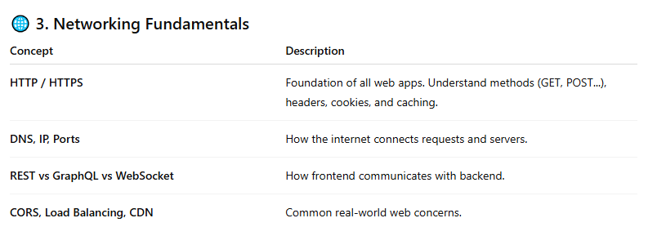
* TCP vs UDP

Slide 6
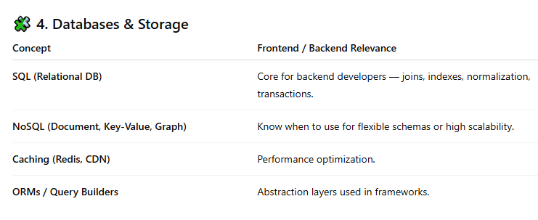

Slide 7
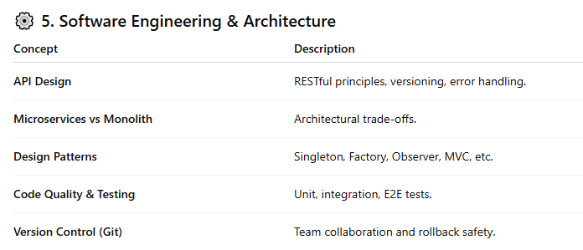

Slide 8
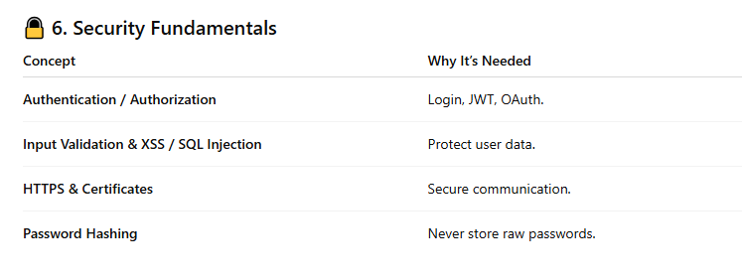
*session
credentials, keys

